Slide 1
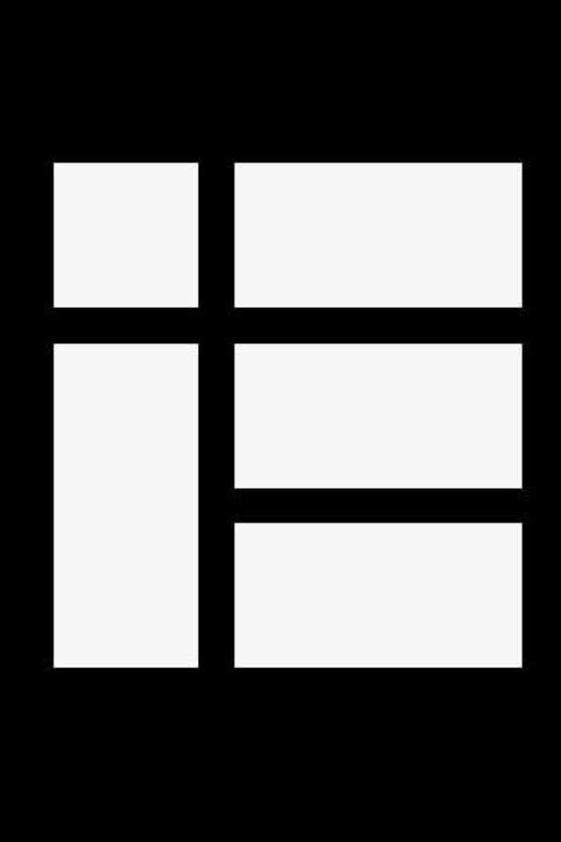

Kotlin Idioms #2

Slide 2

If-not-null Shorthand﻿
val files = File("Test").listFiles()
println(files?.size) // size is printed if files is not null
If-not-null-else Shorthand﻿
val files = File("Test").listFiles()
// For simple fallback values:
println(files?.size ?: "empty") // if files is null, this prints "empty"
// To calculate a more complicated fallback value in a code block, use `run`
val filesSize = files?.size ?: run {
val someSize = getSomeSize()
someSize * 2
}
println(filesSize)

Slide 3

Execute a Statement If Null﻿
val values = ...
val email = values["email"] ?: throw IllegalStateException("Email is missing!")
Get First Item of a Possibly Empty Collection﻿
val emails = ... // might be empty
val mainEmail = emails.firstOrNull() ?: ""
Execute if not null﻿
val value = ...
value?.let {
... // execute this block if not null
}

Slide 4

Map Nullable Value If Not Null﻿
val value = ...
val mapped = value?.let { transformValue(it) } ?: defaultValue
// defaultValue is returned if the value or the transform result is null.
Return on When Statement﻿
fun transform(color: String): Int {
return when (color) {
"Red" -> 0
"Green" -> 1
"Blue" -> 2
else -> throw IllegalArgumentException("Invalid color param value")
}
}

Slide 5

try-catch expression﻿
fun test() {
val result = try {
count()
} catch (e: ArithmeticException) {
throw IllegalStateException(e)
}
// Working with result
}

Slide 6
if expression﻿
val y = if (x == 1) {
"one"
} else if (x == 2) {
"two"
} else {
"other"
}

Slide 7
Builder-style usage of methods that return Unit﻿
fun arrayOfMinusOnes(size: Int): IntArray {
return IntArray(size).apply { fill(-1) }
}

Slide 8
Single Expression Functions﻿
fun theAnswer() = 42
This is equivalent to
fun theAnswer(): Int {
return 42
}
This can be effectively combined with other idioms, leading to shorter code. For example, with the when expression:
fun transform(color: String): Int = when (color) {
"Red" -> 0
"Green" -> 1
"Blue" -> 2
else -> throw IllegalArgumentException("Invalid color param value")
}

Slide 9

Call Multiple Methods on an Object Instance (with)﻿
class Turtle {
fun penDown()
fun penUp()
fun turn(degrees: Double)
fun forward(pixels: Double)
}
val myTurtle = Turtle()
with(myTurtle) { //draw a 100 pix square
penDown()
for (i in 1..4) {
forward(100.0)
turn(90.0)
}
penUp()
}

Slide 10

Configure Properties of an Object (apply)﻿
val myRectangle = Rectangle().apply {
length = 4
breadth = 5
color = 0xFAFAFA
}
Generic function that Requires the Generic Type Information﻿
// public final class Gson {
// ...
// public <T> T fromJson(JsonElement json, Class<T> classOfT) throws JsonSyntaxException {
// ...
inline fun <reified T: Any> Gson.fromJson(json: JsonElement): T = this.fromJson(json, T::class.java)
Swap Two Variables﻿
var a = 1
var b = 2
a = b.also { b = a }
val user = User("John Doe").also {
logUserCreation(it)
saveUserToDatabase(it)
}
val result = mutableListOf<Int>().also {
it.add(1)
it.add(2)
it.add(3)
}

